Slide 1
Data Structure and Algorithm (CS-102)
Dr. Sambit Bakshi
Dept. of CSE, NIT Rourkela

Slide 2
Discussed So far
Here are some of the data structures we have studied so far:
Arrays
Linked list
Stacks, Queues, and Deques

Slide 3
Tree
A tree is defined as a finite set of one or more nodes such that
There is a specially designated node called the root and
The rest of the nodes could be partitioned into n disjoint sets (n>0) each set representing a tree T_{i}, i=1,2, . . . n known as subtree of the tree.
It is a recursive definition!

Slide 4
Tree
A node in the definition of the tree represents an item of information, and
the links between the nodes termed as branches, represent an association between the items of information.

Slide 5
A
Level 0
B
C
D
E
Level 1
F
G
H
I
J
K
Level 2
L
Level 3

Slide 6
Tree
Definition of Tree emphasizes on the aspect of
[a] Connectedness, and
[b] Absence of closed loops
Tree is a undirected graph G(U,V) with all connected nodes and no loops.
But in discussion of computer science, tree is directed and rooted (i.e., one special node is marked as root).

Slide 7
Basic terminologies
degree of the node
leaf nodes or terminal nodes
non terminal nodes
children
siblings
ancestors
degree of a tree
height or depth of a tree
forest

Slide 8
Tree Terminology (continued)
Node: stores the actual data and links to other nodes
Parent: immediate predecessor of a node
Root: specially designated node which has no parent
Child: immediate successor of a node.

Slide 9
Tree Terminology(continued)
Leaf: node without any child
Level: represents the hierarchy.
Node at level i has the level i+1 for its child
and i-1 for its parent.
This is true for all nodes except the root
Level of root node is 0.
Subtree: of a node is a tree whose root is a child of that node

Slide 10
Tree Terminology (continued)
Height of a node: no of edges in the longest path to a leaf from that node
Depth of a node: no of edges in the path from root to that node

Slide 11
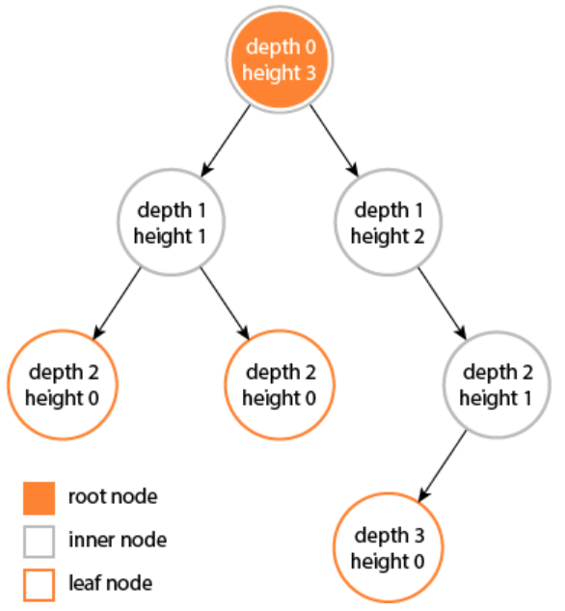

Slide 12
Tree Terminology (continued)
Height of a node: no of edges nodes in the longest path to a leaf from that node
Depth of a node: no of edges nodes in the path from root to that node
[Correct definitions]

Slide 13
Change the values as per the last definition….

Slide 14
Tree Terminology (continued)
Height (depth) of tree: largest no of edges nodes in a path from the root node to a leaf node.
Height of a tree given by h = l_{max}+1, l_{max} is the maximum level of the tree.
Degree of node: number of children for the node

Slide 15
Tree Terminology
Degree of a Tree: Maximum degree of the node in the tree
Siblings: nodes having the same parent
Ancestor of a Node: Those nodes that occur on the path from the root to the given node
Forest : A set of Zero or more Disjoint trees.

Slide 16
Degree of the tree = 4
(Max degree of A)
A
Level 0
B
C
D
E
Level 1
F
G
H
I
J
K
Level 2
Height of the tree = 4
(Max level+1)
L
Level 3

Slide 17
Representation of a tree
List Representation
(A (B(F,G,H), C, D(I), E(J,K(L))) ) for the tree Considered in the Example
Linked List Representation

Slide 18
A
Level 0
B
C
D
E
Level 1
F
G
H
I
J
K
Level 2
L
Level 3

Slide 19
DATA
LINK 1
LINK 2
…
LINK n
(a) General node structure
T
A
B
C
D
E
F
G
H
I
J
K
L
(b) Linked list representation of the tree

Slide 20
An alternative elegant linked representation
TAG DATA / DOWNLINK
LINK
1/0
General node structure
TAG = 1 when next part contains DATA (for root of the subtree and its leaf children),
TAG = 0 when next part contains DOWNLINK (for non-leaf children)

Slide 21
An alternative elegant linked representation
1
A
0
1
C
0
0
1
B
1
F
1
G
1
H
1
D
1
I
1
E
1
J
O
1
K
1
L
(b) Linked representation of the tree

Slide 22
Left Child - Right Sibling representation
data
left child
right sibling
A
B
C
D
E
F
I
J
K
G
H
L

Slide 23
Binary Trees
A binary tree T is defined as a finite set of elements called nodes such that
[a] T is empty or bears zero nodes (Called the Null tree or Empty tree) or
[b] T contains a distinguished node R called the root of T and the remaining nodes of T form an ordered pair of disjoint binary trees T₁ and T₂

Slide 24
Binary Trees
A binary tree has the characteristic of all nodes having at most two branches, that is, all nodes have a degree of at most 2.
A binary tree can therefore be empty or consist of a root node and two disjoint binary trees termed left subtree and right subtree.

Slide 25
A
Level 0
B
C
Level 1
D
E
F
G
Level 2

Slide 26
Important observations regarding binary trees:
The maximum number of nodes on level i of a binary tree is 2^{i}, i>0
The maximum number of nodes in a binary tree of height h is 2^{h}-1, h>1
2⁰+2¹+2²+…+2^{h-1}=2^{h}-1
For any non empty binary tree, if t_{o} is the number of terminal nodes and t₂ is the number of nodes of degree 2, then t_{o}=t₂+1

Slide 27
A binary tree of height h which has all its permissible maximum number of nodes viz.,
2^{h}-1 intact is known as a perfect binary tree of height h.
1
A
2
B
C
3
D
E
6
F
G
4
5
7

Slide 28
A binary tree of height h which has all nodes with either 0 or 2 children is known as a strict / full binary tree of height h.
1
A
2
B
C
3
6
F
G
7

Slide 29
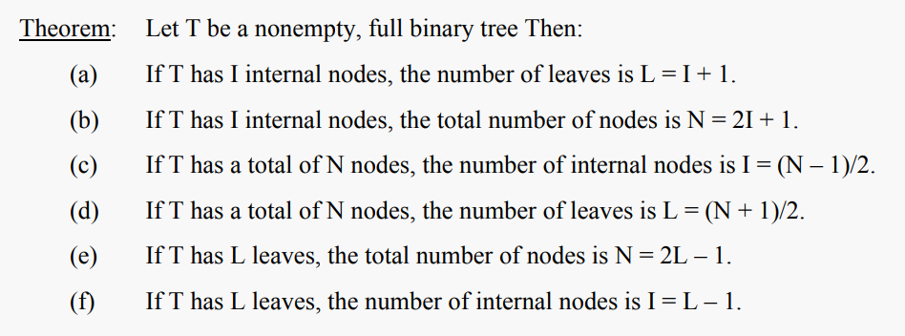

Slide 30
A binary tree with n’ nodes and height h is complete if its node numbers correspond to the node numbers 1 to n (n’≤ n) in a perfect binary tree of height h.
Height of a complete binary tree with n given by
A
1
B
C
3
2
4
D
E
F
5
6

Slide 31
In a complete binary tree, every level, except possibly the last, is completely filled, and all nodes in the last level are as far left as possible.

Slide 32
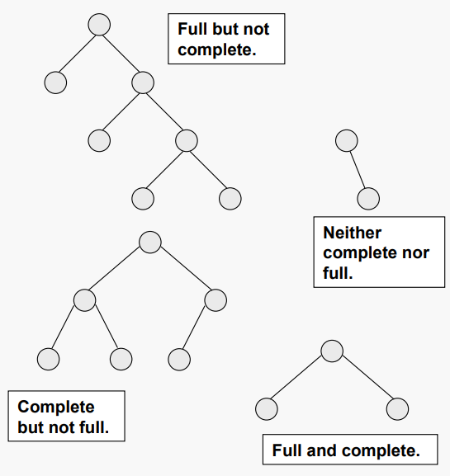

Slide 33
A complete binary tree obeys the following properties with regard to its node numbering:
[a] If a parent node has a number i then its left child has the number 2i (2i < n).
-- If 2i > n then i has no left child.
[b] If a parent node has a number i, then its right child has the number 2i+1 (2i + 1 <n).
-- If 2i + 1 > n then i has no right child.
[c] If a child node (left or right) has a number i then the parent node has the number ⎣i /2⎦ if i ≠1. If i =1 then i is the root and hence has no parent.

Slide 34
Is every full binary tree a complete binary tree?
Is every complete binary tree a full binary tree?

Slide 35
A binary tree which is dominated solely by left child nodes or right child nodes is called a skewed binary tree or more specifically left skewed binary tree or right skewed binary tree respectively.
a
m
b
n
c
o
d
Left skewed
Right skewed
p

Slide 36
Extended Binary Tree: 2-Tree
A binary tree T is said to be 2-Tree or an extended binary tree if each node N has either 0 or 2 children.
Nodes with 2 children are called internal nodes and the nodes with 0 children are called external nodes.

Slide 37
Representation of Binary Tree
Binary tree can be represented by means of
[a] Array
[b] linked list

Slide 38
Representation Of Binary Trees
Array Representation
1
Sequential representation of a tree with depth d will require an array with approx 2^{d}-1 elements
a
2
b
4
5
c
d
10
e
f
11
1 | 2 | 3 | 4 | 5 | 6 | 7 | 8 | 9 | 10 | 11
a | b |  | c | d |  |  |  |  | e | f

Slide 39
Array Representation
A
[1]
[2]
[3]
[4]
[5]
[6]
[7]
[8]
[9]
.
[16]
A
B
--
C
--
--
--
D
--
.
E
B
C
D
E
Memory wastage !!

Slide 40
Linked representation
T
LCHILD
DATA
RCHILD
a
b
c
d
e
f

Slide 41
Observation regarding the linked representation of Binary Tree
[a] If a binary tree has n nodes then the number of pointers used in its linked representation is 2 * n
[b] The number of null pointers used in the linked representation of a binary tree with n nodes is n + 1

Slide 42
Traversing Binary Tree
Three ways of traversing the binary tree T with root R
Preorder
[a] Process the root R
[b] Traverse the left sub-tree of R in preorder
[c] Traverse the right sub-tree of R in preorder
a. k. a node-left-right traversal (NLR)

Slide 43
Traversing Binary Tree
In-order
[a] Traverse the left sub-tree of R in in-order
[b] Process the root R
[c] Traverse the right sub-tree of R in in-order
a. k. a left-node-right traversal (LNR)

Slide 44
Traversing Binary Tree
Post-order
[a] Traverse the left sub-tree of R in post-order
[b] Traverse the right sub-tree of R in post-order
[c] Process the root R
a. k. a left-right-node traversal (LRN)

Slide 45
Illustrations for Traversals
Assume: visiting a node
is printing its label
Preorder:
1 3 5 4 6 7 8 9 10 11 12
Inorder:
4 5 6 3 1 8 7 9 11 10 12
Postorder:
4 6 5 3 8 11 12 10 9 7 1
1
3
7
5
8
9
10
4
6
11
12

Slide 46
Illustrations for Traversals (Contd.)
Assume: visiting a node
is printing its data
Preorder: 15 8 2 6 3 7
11 10 12 14 20 27 22 30
Inorder: 2 3 6 7 8 10 11
12 14 15 20 22 27 30
Postorder: 3 7 6 2 10 14
12 11 8 22 30 27 20 15
15
8
20
2
11
27
6
10
12
22
30
3
7
14

Slide 47
Euler’s Tree traversals using “flags”
The order in which the nodes are visited during a tree traversal can be easily determined by imagining there is a “flag” attached to each node, as follows:
preorder
inorder
postorder
To traverse the tree, collect the flags:
A
A
A
B
C
B
C
B
C
D
E
F
G
D
E
F
G
D
E
F
G
A B D E C F G
D B E A F C G
D E B F G C A

Slide 48
Formulation of Binary tree from Its traversal
Easy if one given traversal sequence in inorder.
1. If preorder is given=>First node is the root
If postorder is given=>Last node is the root
2. Once the root node is identified ,all nodes in the left subtrees and right subtrees of the root node can be identified from inorder.
3. Same technique can be applied repeatedly to form subtrees

Slide 49
Example: For Given Inorder and Preorder
Inorder: D B H E A I F J CG
Preorder: A B D E H C F I J G
Now root is A
Left subtree: D B H E
Right subtree: I F J C G

Slide 50
continued…
In: D B H E A I F J CG
Pre: A B D E H C F I J G
D B H E I F J C G
B D E H C F I J G
D H E I F J G
E H F I J
H I J

Slide 51
Example: For Given Inorder and Postorder
Inorder: n1,n2, n3, n4, n5, n6, n7, n8, n9
Postorder: n1,n3, n5, n4, n2, n8, n7, n9, n6
So here n6 is the root

Slide 52
n6
In:n1,n2,n3,n4,n5
n7,n8,n9
Post:n1,n3,n5,n4,n2
n8,n7,n9
n1
n3,n4,n5
n7,n8
n3,n5,n4
n8,n7
n3
n5
n8

Slide 53
Given Preorder & Postorder
Tree may not be unique
preorder: A B C
postorder: C B A
A
A
B
B
C
C
Tree-1
Tree-2

Slide 54
Given Preorder & Postorder
First node in preorder is ROOT (same as last node in postorder)
Find previous node of ROOT in postorder (say X) and locate it in preorder
Nodes before X in preorder is the left subtree of ROOT
X and nodes after X in preorder is the right subtree of ROOT
Repeat stepts 1 to 5 until each subtree contains one element

Slide 55
Given Preorder & Postorder
Pre: A B C D F G E
Post: C F G D B E A
Pre: B C D F G
Post: C F G D B
Pre: E
Post: E
Pre: C
Post: C
Pre: D F G
Post: F G D
Pre: F
Post: F
Pre: G
Post: G

Slide 56
Given pre-order and post order traversal of a tree, can you accurately generate back the tree?
Answer: Not always
Example:
A
A
B
B
C
C
Pre: A B C D
Post: D C B A
D
D

Slide 57
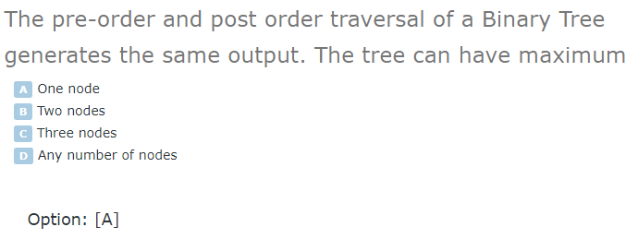

Slide 58
Traversal Algorithm Using Stack
Binary Tree is represented by
TREE(INFO, LEFT, RIGHT, ROOT)
A pointer PTR will contain the location of the node N currently being scanned.
An array STACK will hold the addresses of the node for future processing

Slide 59
Pre-order tree traversal with a stack
Push root onto the stack
While stack is not empty
Pop a vertex off stack, and write it to the output list
Push its children right-to-left onto stack
Step Output Stack
0 A
1 A C,B
2 B C,D
3 D C,H,G
4 G C,H
5 H C,K
6 K C
7 C F,E
8 E F
9 F --
A
B
C
D
E
F
G
H
K

Slide 60
In-order Traversal with a stack
[1] [Push NULL onto STACK and initialize PTR]
Set TOP =1, STACK[1] = NULL, PTR = ROOT
[2] Repeat while PTR ≠ NULL [Push the Left-most path onto STACK]
(a) Set TOP = TOP + 1, STACK[TOP] = PTR
(b) Set PTR = PTR → LEFT
[3] Set PTR = STACK[TOP], TOP = TOP -1 [Pops node from STACK]
[4] Repeat Steps 5 to 7 while PTR ≠ NULL: [Backtracking]
[5] Apply PROCESS to PTR→INFO
[6] [Right Child ?] If PTR→RIGHT ≠ NULL then
(a) Set PTR = PTR→RIGHT
(b) Go to Step 2
[7] Set PTR = STACK[TOP], TOP = TOP -1
[8] Exit

Slide 61
In-order Traversal with a stack
[1] Push the Left-most path from ROOT onto STACK
[2] While STACK is not empty
Pop and process node X
If Right Child of X (say Y) exists then
Push left most path from Y onto STACK

Slide 62
In-order Traversal with a stack
[1] Push the Left-most path from ROOT onto STACK
[2] While STACK is not empty
Pop and process node X
If Right Child of X (say Y) exists then
Push left most yet unprocessed path from Y onto STACK
Step Output Stack
1 A,B,D,G,K
2 K A,B,D,G
3 G A,B,D
4 D A,B,H,L
5 L A,B,H
6 H A,B,M
7 M A,B
8 B A
9 A C,E
10 E C
11 C --
A
B
C
D
E
G
H
K
L
M

Slide 63
Self Study
Write an algorithm to traverse a binary tree in postorder traversal using stack. Discuss the algorithm with an example.

